Slide 1
Identifying school-level factors that drive long-term outcomes for students from regional, rural and remote areas in Australia: evidence from two large-scale national cohort studies
Wojtek Tomaszewski, Francisco Perales, Ning Xiang, Melissa Johnstone
The University of Queensland, Australia

Slide 2
Overview of the project
Funded through a grant from the Queensland Government Department of Education
Aim: leveraging two major longitudinal national surveys to explore what school factors predict successful long-term outcomes for students from regional, rural and remote (RRR) communities in Australia
School factors captured across multiple domains: school safety; academic climate; provision of career guidance; relational aspects; institutional environment
This presentation: focus on career guidance
Broad range of outcomes at various points of student trajectory: wellbeing, social & emotional outcomes; academic performance at school; educational attainment: enrolment in university, vocational education, completing university; labour market outcomes: being employed, obtaining high-status occupation, high earnings
This presentation: focus on tertiary education and employment outcomes

Slide 3
Regional, rural and remote areas in Australia
Remoteness area | 2016 population | %
Major cities | 17,331,653 | 71.59
Inner regional | 4,341,032 | 17.93
Outer regional | 2,041,946 | 8.43
Remote | 293,765 | 1.21
Very remote | 202,413 | 0.84
Total | 24,210,809 | 100

Slide 4
Disadvantage of students from RRR communities in Australia
RRR a unique group within the Australian context, given the vast geographic distances between rural and urban centres
students in RRR areas often lack access to important material and immaterial resources and high-quality social, community and educational services
The educational outcomes for RRR students has been one of the focal points for policy efforts in Australia (Bennett et al., 2015; Halsey, 2017; Lamb, Jackson, Walstab, & Huo, 2015; Wallace & Boylan, 2009)
Despite various policy endeavours, RRR students:
have lower academic achievement (ACARA, 2019)
have lower participation rates in higher education (Halsey, 2018)
report worse mental health conditions (Rossiter et al., 2018)
are less likely to be fully engaged in work and/or study (ABS, 2019)

Slide 5
The relevance of career guidance for addressing disadvantage
Disparities of career readiness among youth from different socio-economic backgrounds (e.g., Covacevich et al., 2021; Mann et al., 2020)
Career guidance provided by schools can help address such disparities (e.g., Tomaszewski et al., 2017) because, in comparison with their more advantaged peers, disadvantaged students:
Rely more on schools and teachers as sources of information (Ball & Vincent, 1998)
Value their teachers’ advice and encouragement more (Gore et al., 2015)
Place extra weight on the guidance provided by career advisors (James, 2000)
Are more positive about their career guidance experiences (Rothman & Hillman, 2008)
However, lack of evidence focusing on RRR students specifically: one of the contributions of this project

Slide 6
The life course approach
The life course approach is an increasingly influential lens through which researchers can study the intersections between socio-economic status and educational inequalities (Elder, 1995; Elder et al., 2003)
This project examines the effects of school factors (including career guidance) on a broad range of outcomes, across various stages of the student life cycle:
Primary school (school functioning; socio-emotional development; cognitive development; academic achievement)
Secondary school (school functioning; socio-emotional development; academic achievement; school belonging; life satisfaction)
Tertiary education (year 12 completion; university enrolment; VET enrolment; university completion)
Labour market outcomes (being employed; managerial/professional occupation; earning a high wage)

Slide 7
Research questions
What are the differences between RRR and urban Australian youth in educational and labour market outcomes?
What are the effects of career guidance received in school on these outcomes?
What are the aspects of career guidance that are particularly relevant to students from RRR communities?

Slide 8
Data
The Longitudinal Study of Australian Children (LSAC)
Started with two cohorts of children in 2004 (cohort aged 4-5 in 2004 is the focus of this study)
Nationally representative sample
Interviews every two years
16 years of data from 4,982 participants aged 4/5 -18/19
The Longitudinal Surveys of Australian Youth (LSAY)
Multiple student cohorts (2009 cohort is the focus of this study)
Nationally representative samples
Following young people from age 15 up to 25 using annual interviews
Using PISA sample as a starting point
Waves 1-3 used to capture school factors (including career guidance); waves 2-11 used to track outcomes
Analytic dataset N=8,118

Slide 9
Key variables
Key independent variable: students in RRR communities (29%) vs metro students (71%)
Career guidance provided through school
School helped to make decision about what to do after leaving school
School helped to choose subject for future study
School helped to apply for a job
Talked to career advisors
Attended talks about job
Attended career expo
Attended TAFE/university information sessions
Educational and labour market outcomes
Commenced bachelor study
Commenced VET study
Obtained bachelor (or above) degree
Employed
Entered managerial/professional occupation
Earned top quartile hourly wage
Control variables: gender, age, Indigenous status, immigrant status, family structure, family SES, PISA math scores, and school factors (i.e., school sector, school size, quality of school educational resources)

Slide 10
Analytic approach
Analyses of main effects: to determine the existence and magnitude of differences in outcomes between RRR students and metro students
Mediation analyses: whether exposure to different school factors is responsible for any observed differences in outcomes between RRR students and metro students
Moderation analyses: whether certain school factors improve the outcomes of RRR students to a greater extent than those of metro students
Analyses of cumulative exposure: how the intensity of exposure to multiple school-level factors influences their outcomes
Analytic methods: random effect models, growth curve models, event history analysis
This presentation focuses on results from event history (survival/hazard) analyses, which model time to an event (university/VET commencement, university completion, entry into professional/managerial occupation, reaching earnings in the top quartile of the distribution)

Slide 11
Outcomes – the relevance of RRR background

Slide 12
Most important sources of career information perceived by students
Source of career information | RRR % | Metro %
Talk to parents or family | 28.6 | 29.9
Talk with career advisor | 21.1 | 22.2
Talk with someone about their job | 9.9 | 9.4
University Information Session | 8.1 | 9.4
Careers expo | 8.0 | 8.4
Don’t know | 6.7 | 5.4
On-line career guidance | 5.9 | 6.3
Talk to friends or other students | 4.5 | 4.4
Attending an organised visit to a workplace | 4.5 | 2.7
VET Information Session | 1.8 | 1.1
Answering questionnaire about interests and abilities | 0.9 | 0.9
Missing | 0.04 | 0.1
Total n | 2,337 | 5,781

Slide 13
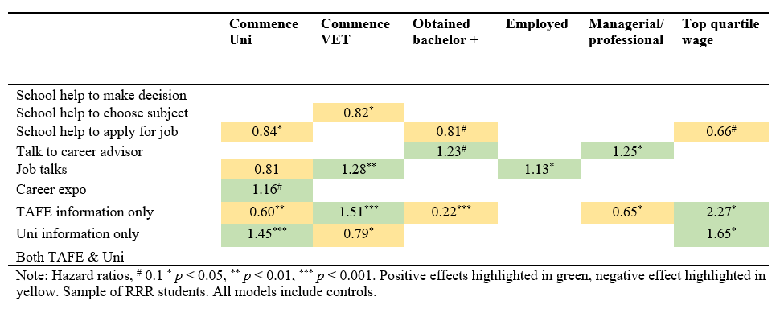
Associations between career guidance and educational and labour market outcomes among RRR students

Slide 14
Associations between career guidance and educational and labour market outcomes among RRR students

Slide 15
Conclusions
Compared with urban peers, RRR students are:
less likely to enrol and complete university degree, and more likely to enrol in VET and enter employment at younger age
less likely to be employed in professional/managerial occupation but earnings are comparable
Similar to urban students, RRR students identify talking to parents/family and career advisor as most important influences on their career choices
Talking to career advisor in schools is associated with increased likelihood of completing university and entering a managerial/professional occupation among RRR students
Attending a job talk is associated with higher likelihood of commencing VET and entering employment
Attending a VET/university information session associated with higher likelihood of commencing VET/university and (in both cases) with increased likelihood of high earnings among RRR students
However, in the case of VET, attending information session lowers the probability of employment in managerial/professional occupation – hinting at the differences between VET and university pathways

Slide 16
Implications for policy and future research
Focus on early career provision: many choices already cemented by upper-secondary, which may explain some of the results reported here (e.g. TAFE/university information sessions)
Some forms of career advice appear to be particularly relevant for improving outcomes in RRR students, including talking to career advisor and university/TAFE information sessions
highlights the importance of provision of quality information in schools to help students finalise their decisions about post-school destination
The importance of outside-school sources of advice and information (e.g. family, friends) needs to be recognised – important to provide parents with the same quality information as provided to students in schools
Avenues for future research include:
in-depth studies aimed at understanding the decision-making processes around careers (and the role of career advice) among RRR students, including considerations for barriers they may be facing
Studies piloting different modes of providing students (and their parents) with quality information about career choices, including data on the likely outcomes associated with these choices

Slide 17
Thank you
A/Prof Wojtek Tomaszewski
Research Group Leader
Institute for Social Science Research
The University of Queensland
w. tomaszewski@uq.edu.au
+61 7 3346 9305

